Slide 1
JIRA
1.JIRA LOGIN
2.Its open empty backlogs page
3.Create Epic in Home page
4.Create a story in Register,login,contact pages
5.Start Spirit

Slide 2
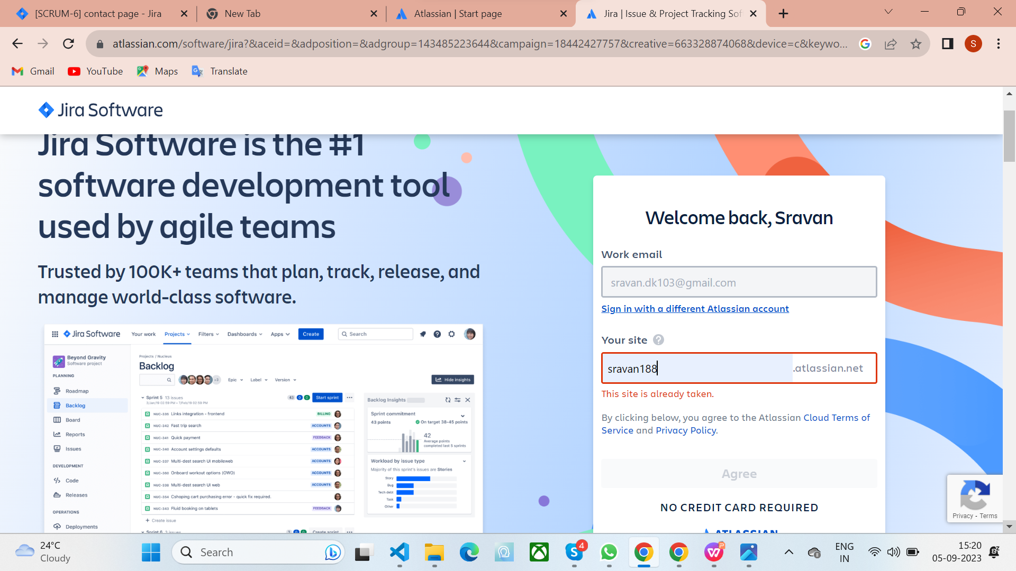
Jira login

Slide 3
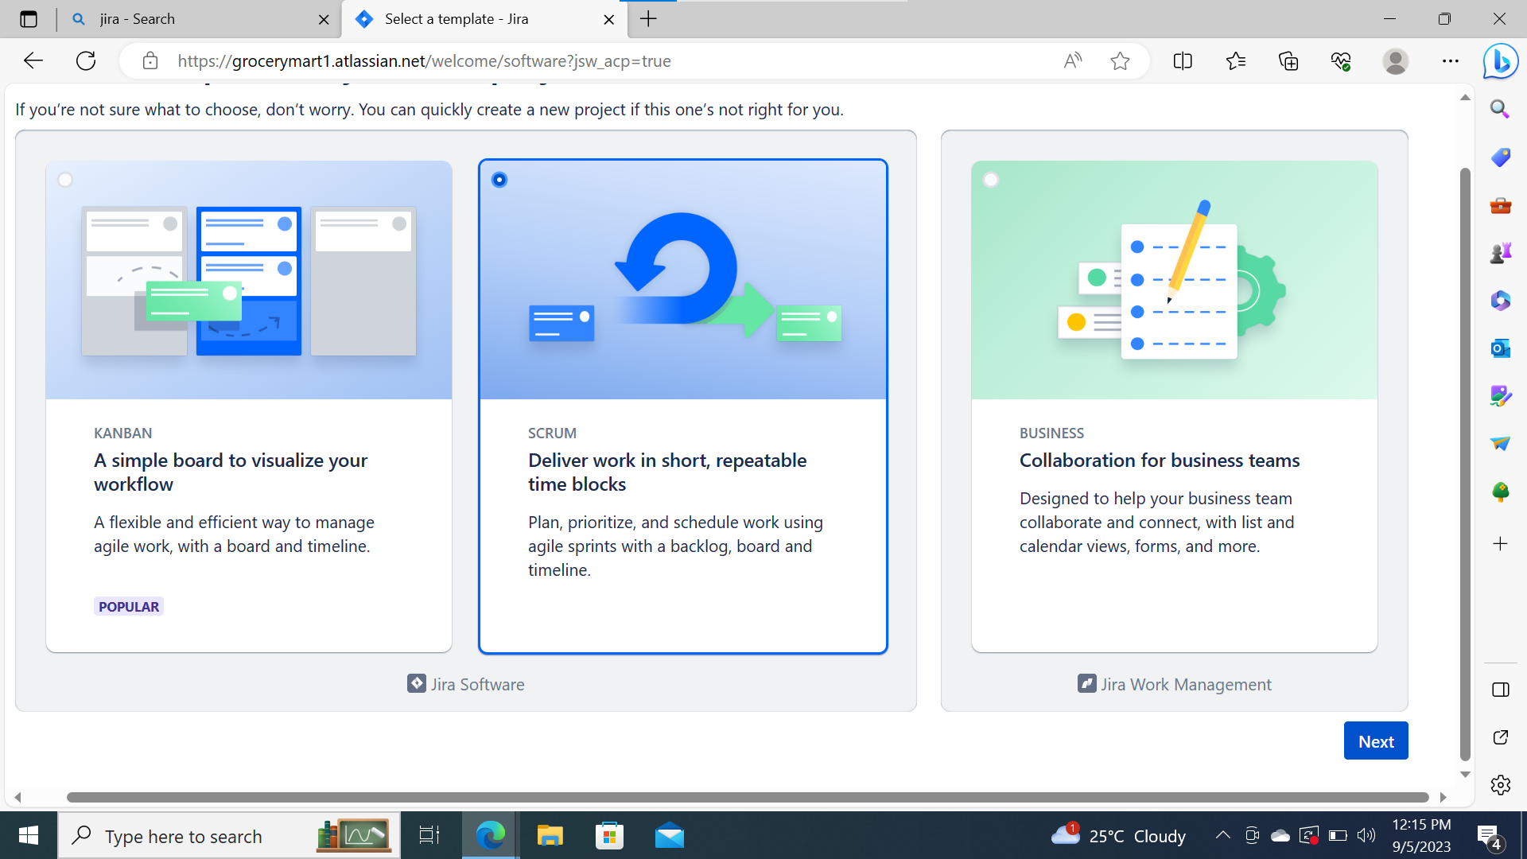

Slide 4
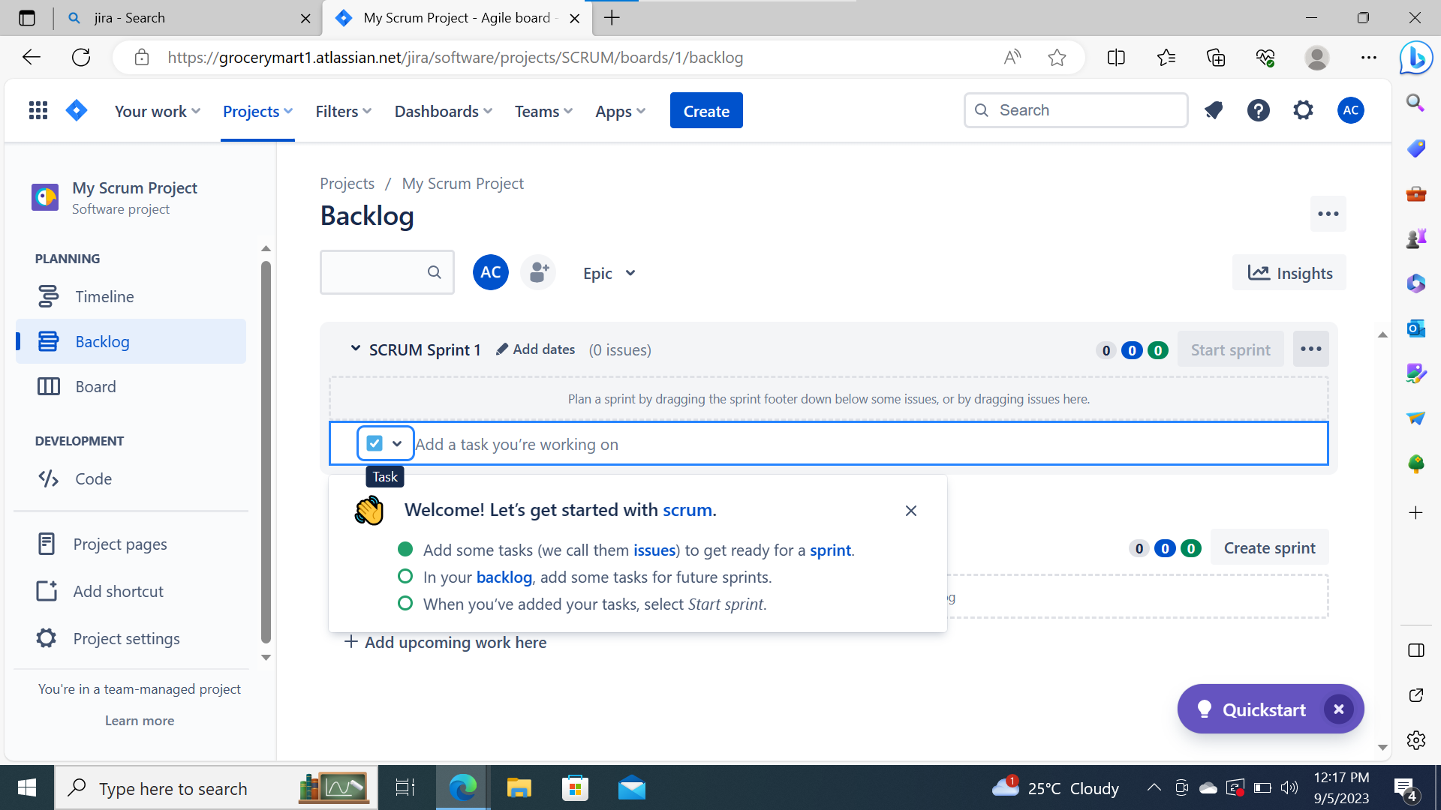
Its open a Empty Backlog

Slide 5
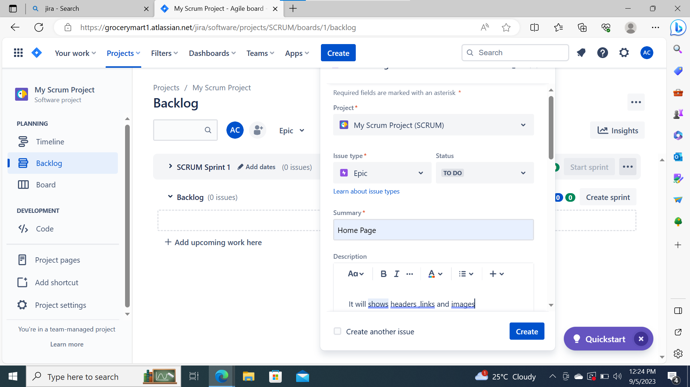
Create a Home page an Epic

Slide 6
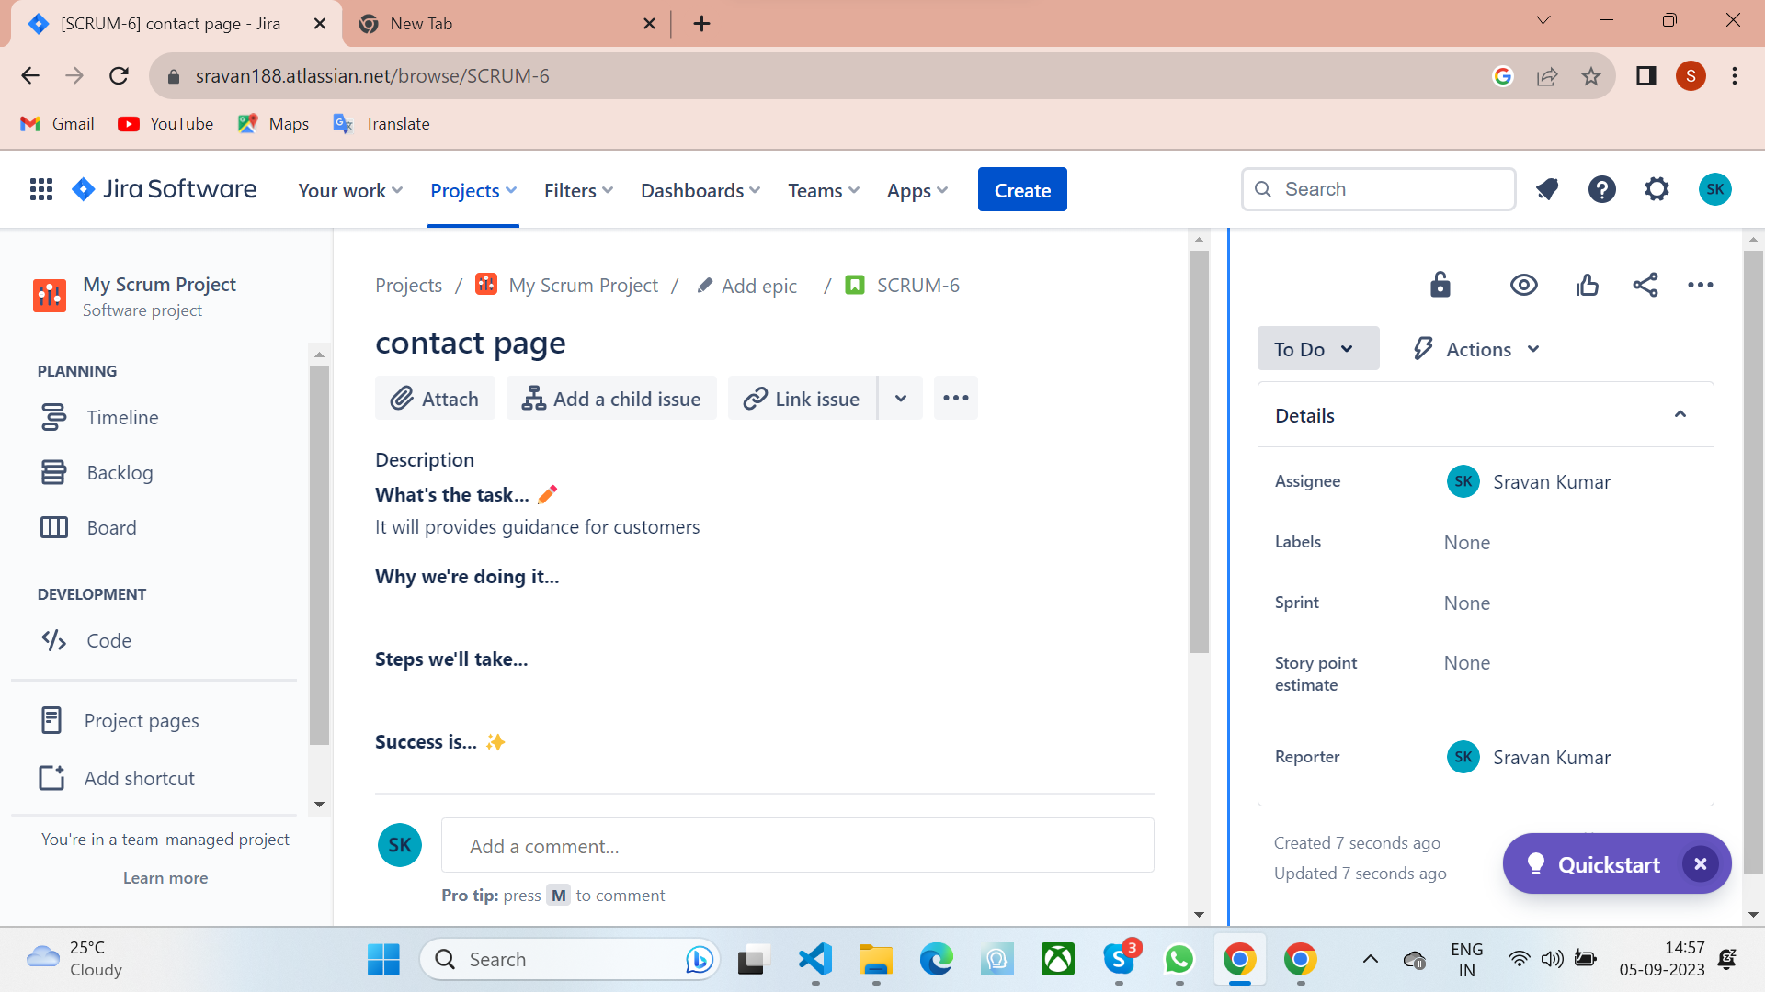
Create a Contact page an Story

Slide 7
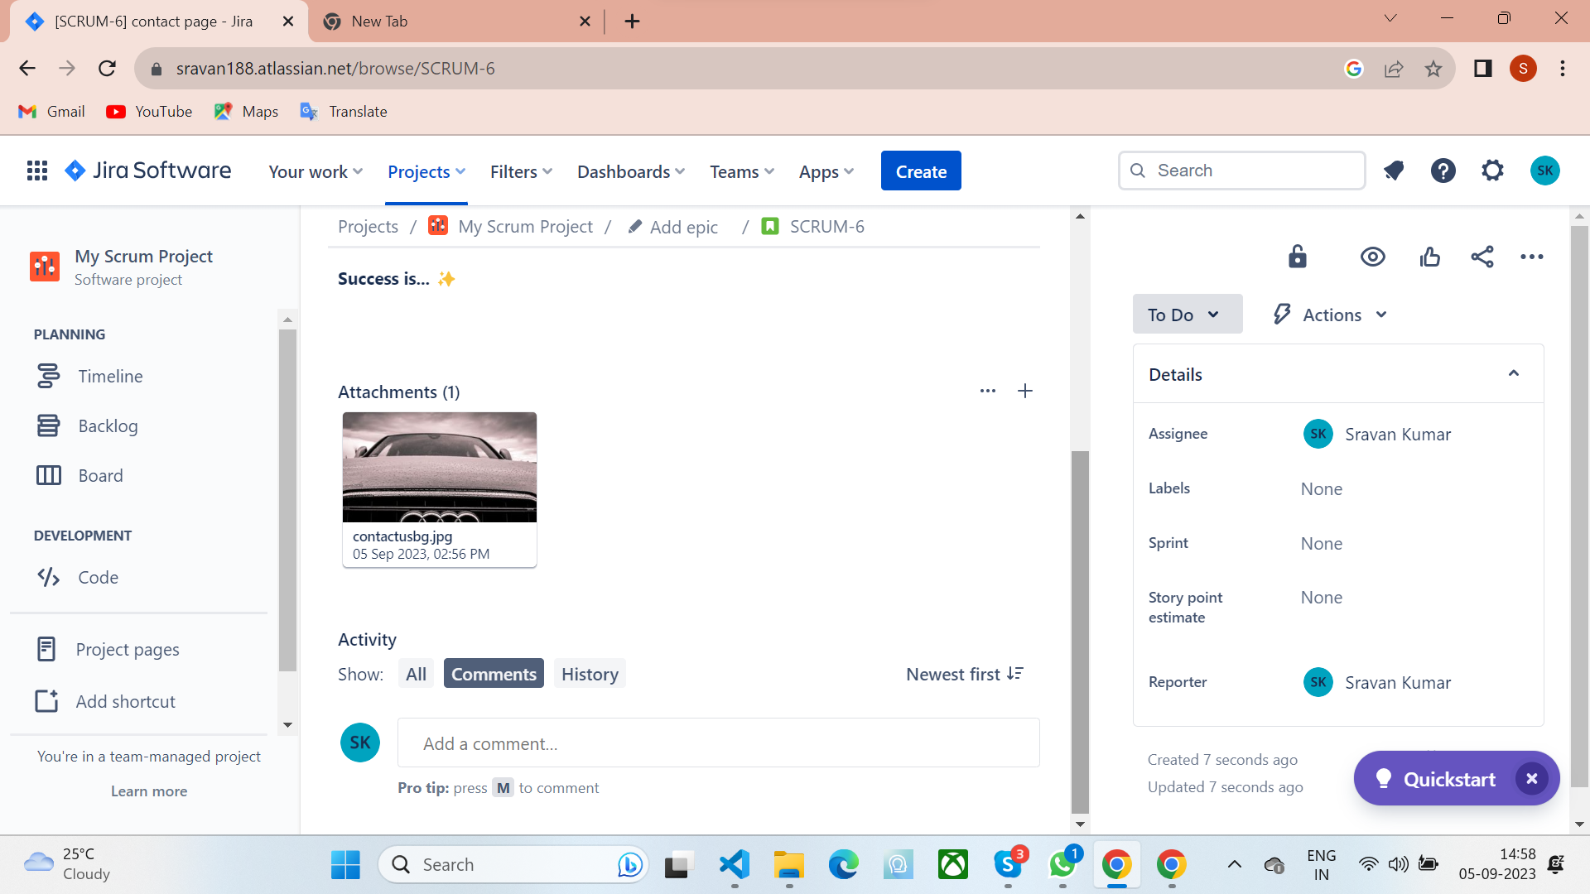

Slide 8
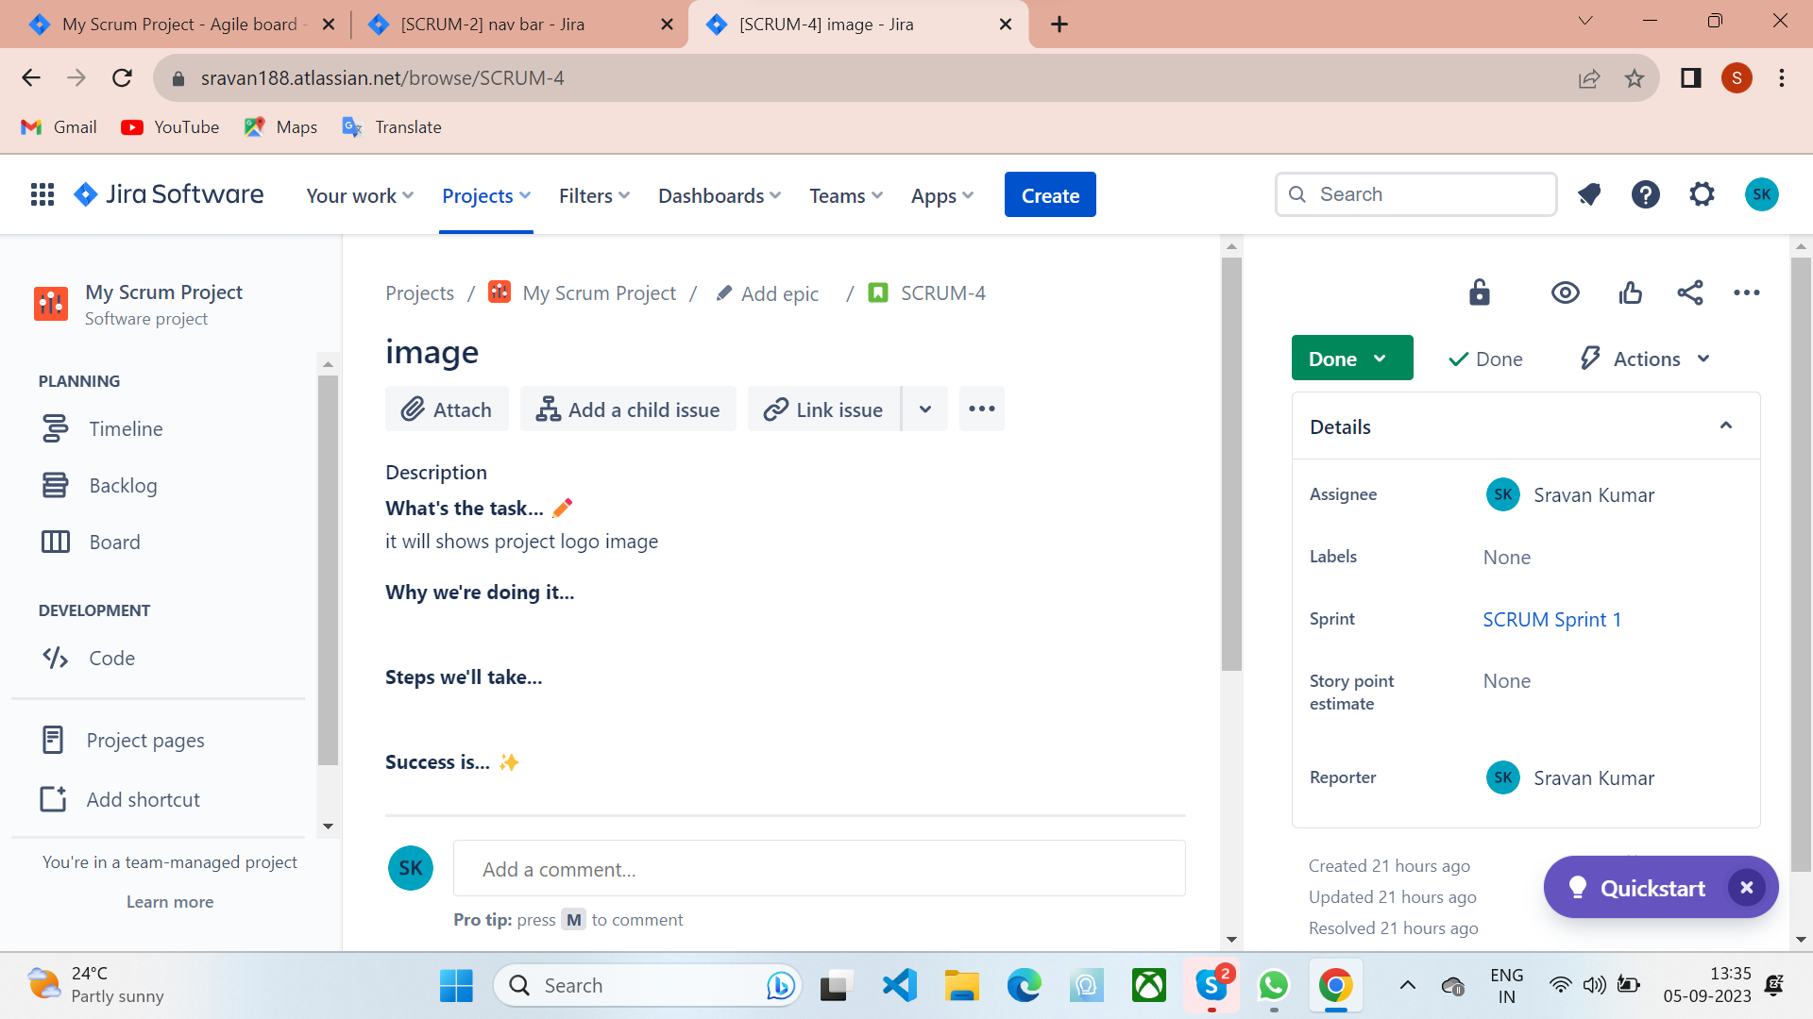
Create a images in home page

Slide 9
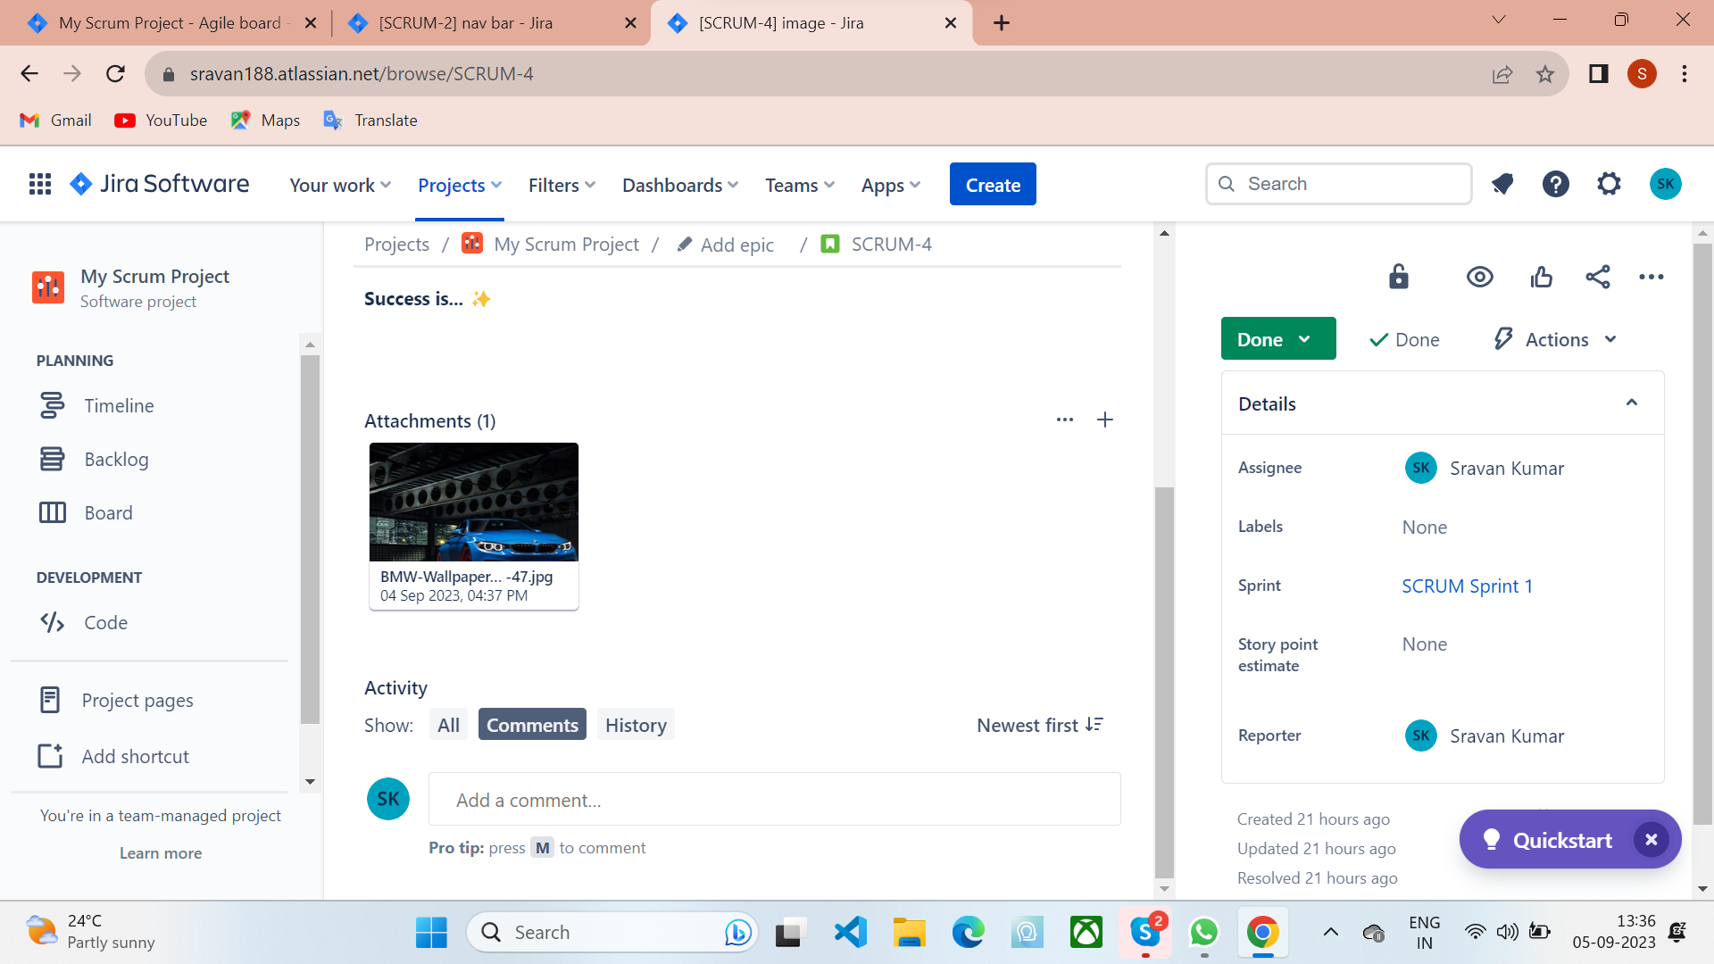

Slide 10
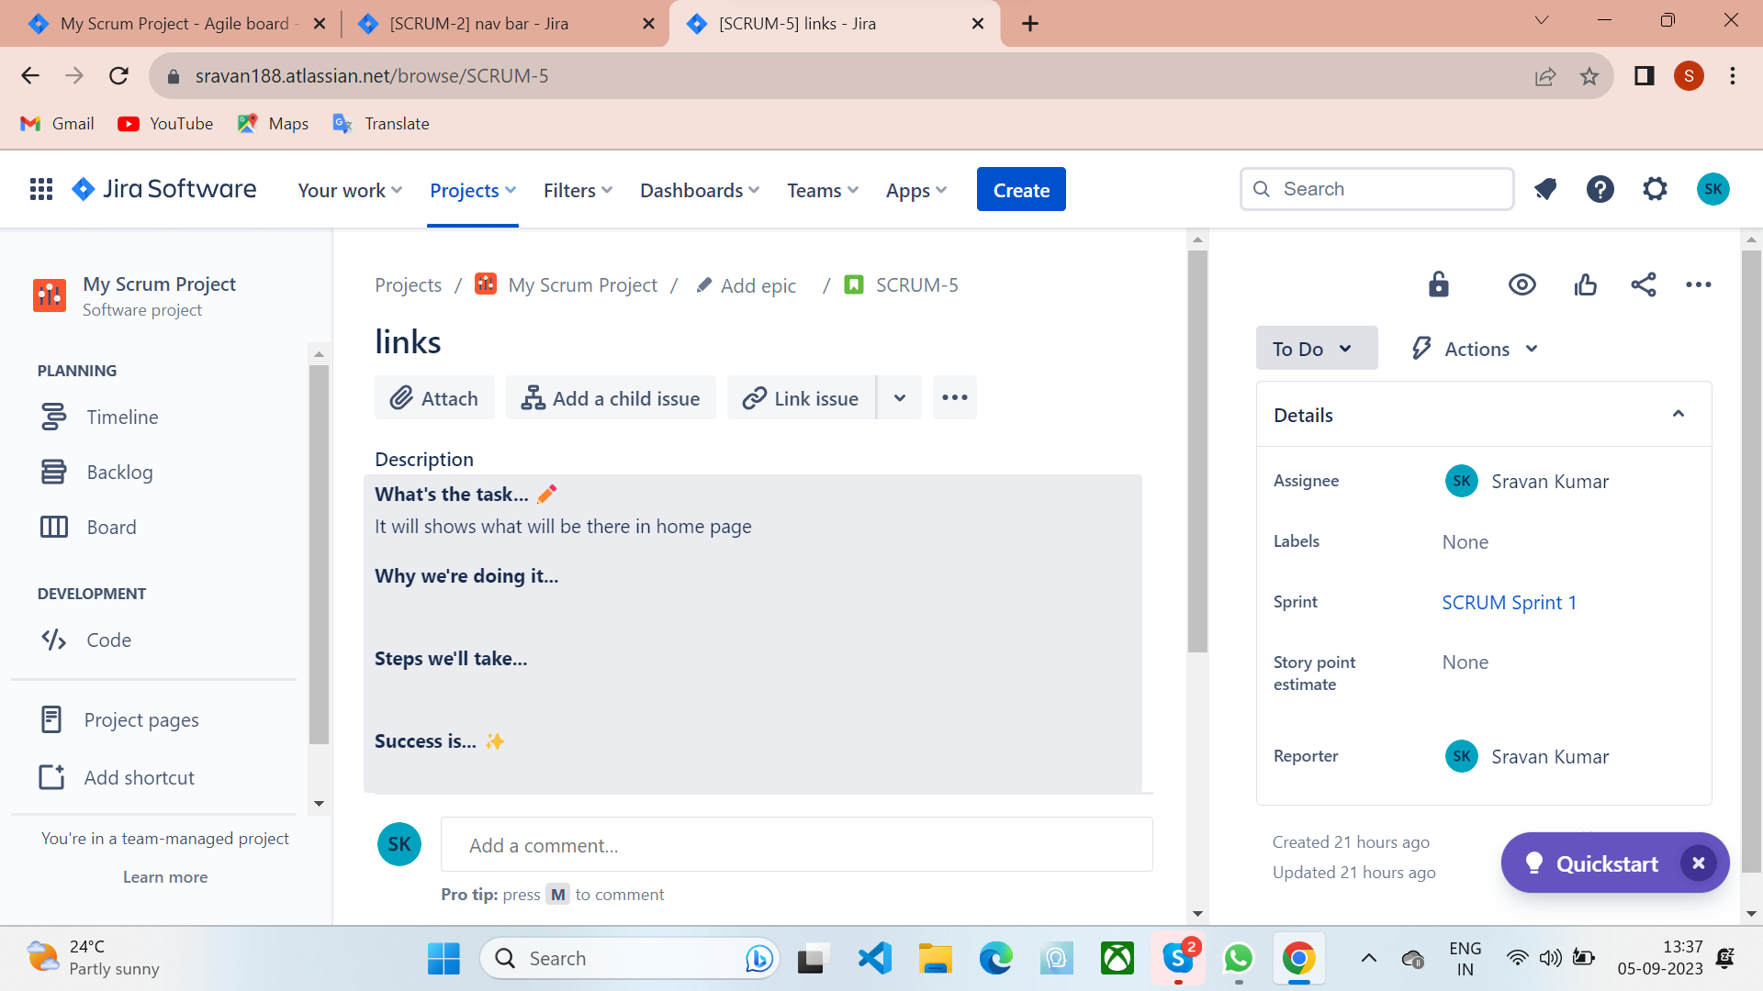
Create a links in home page

Slide 11
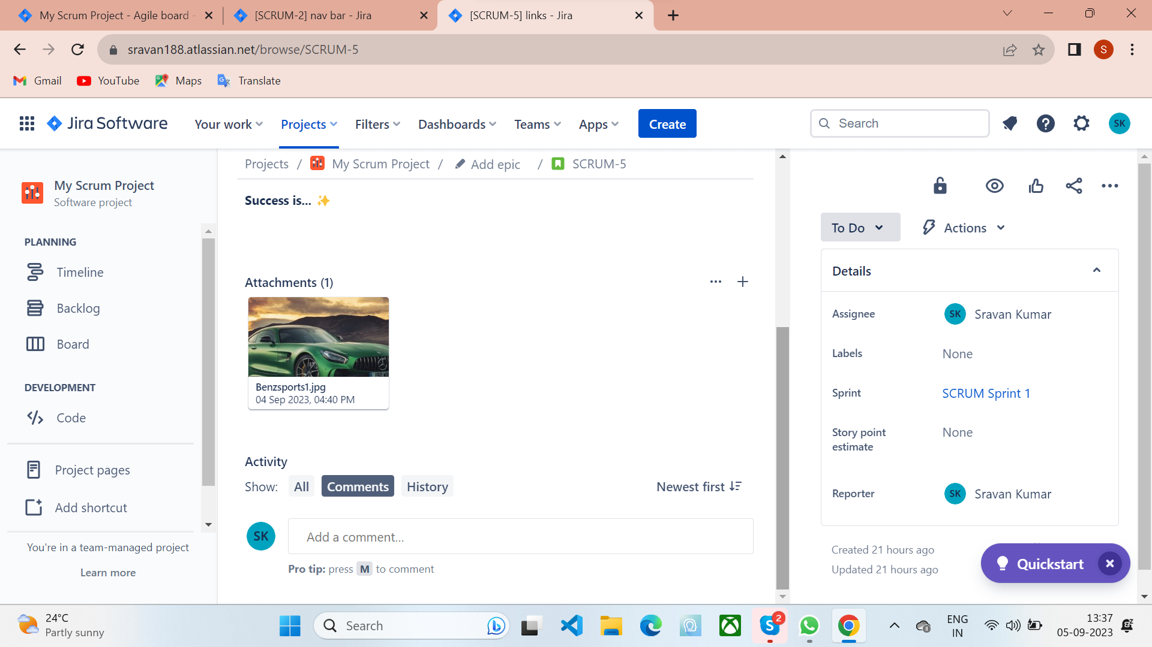

Slide 12
Three storys in Backlog

Slide 13
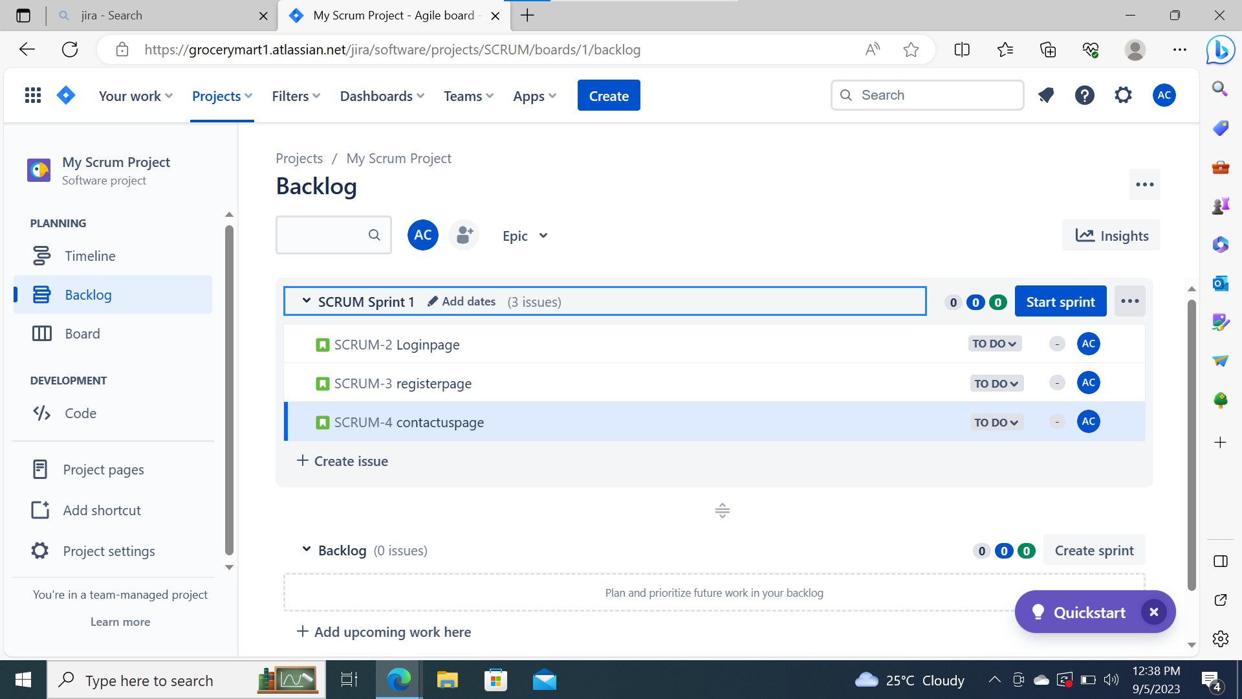
Three Storys in Scrum Sprint

Slide 14
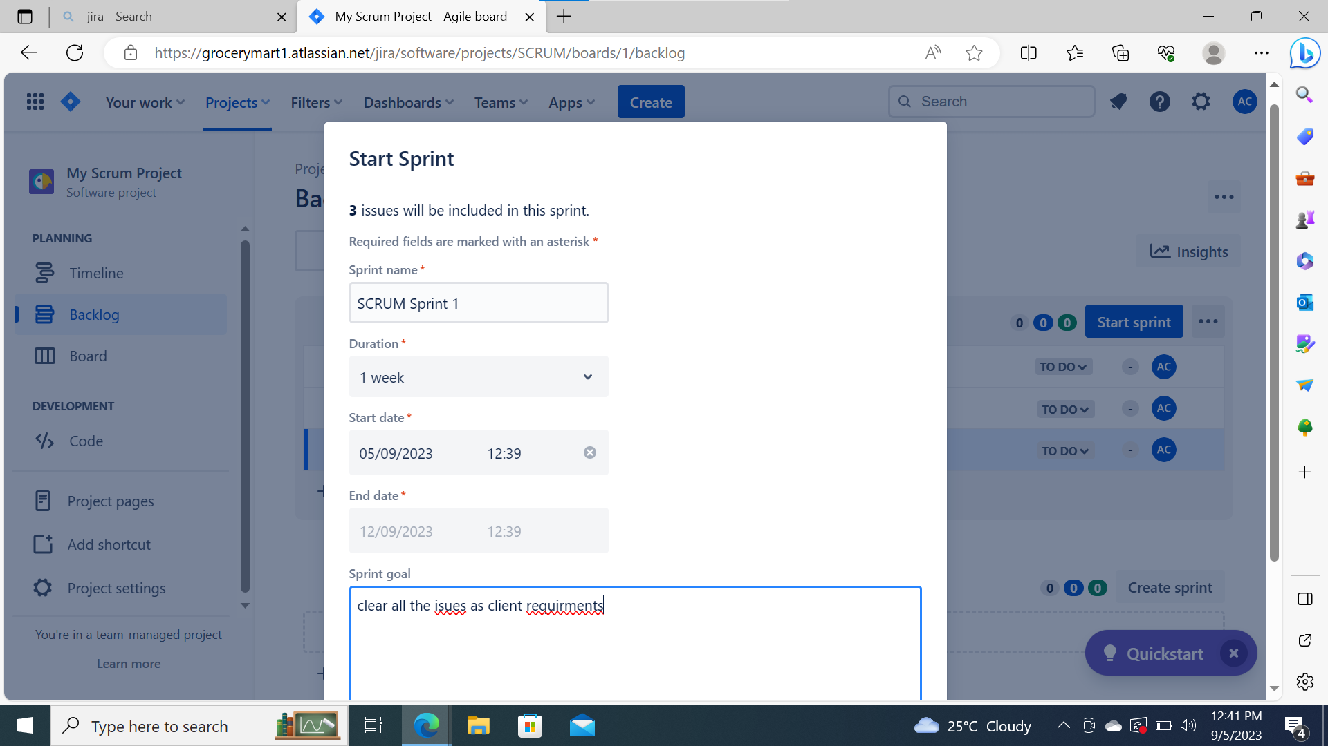
Can Start Sprint

Slide 15
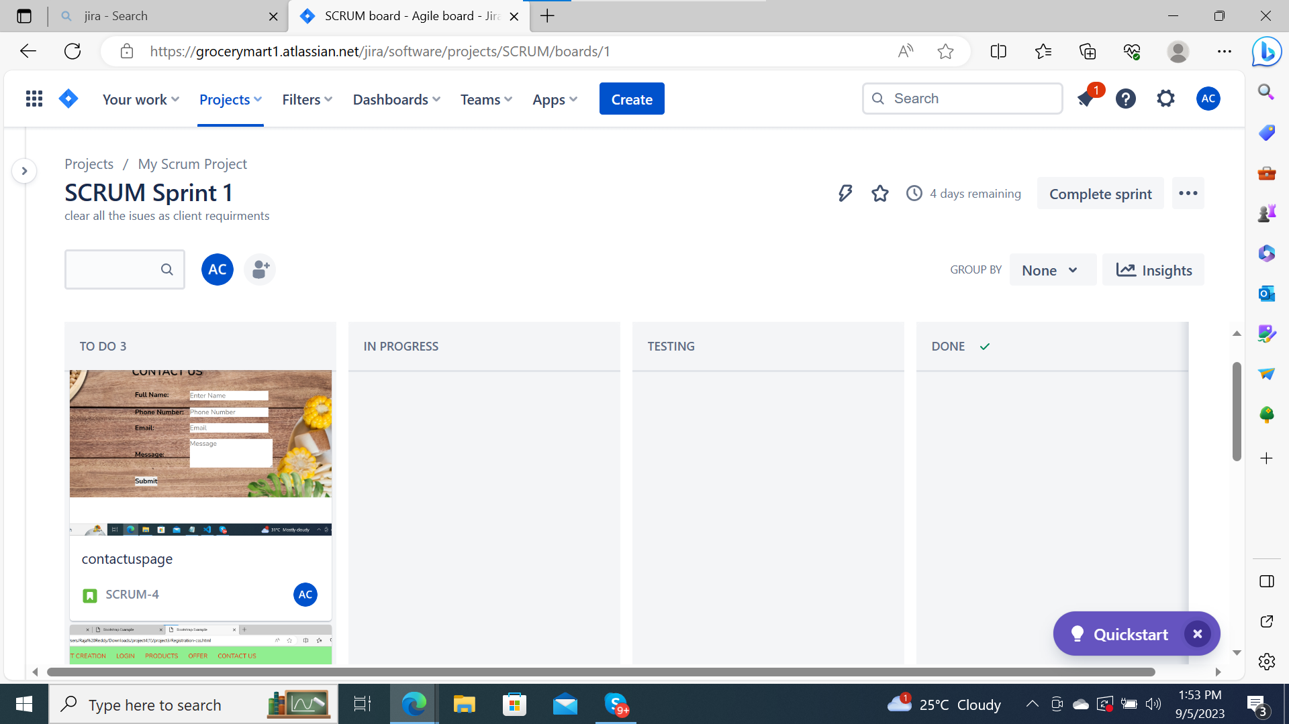
Scrum Sprint

Slide 16
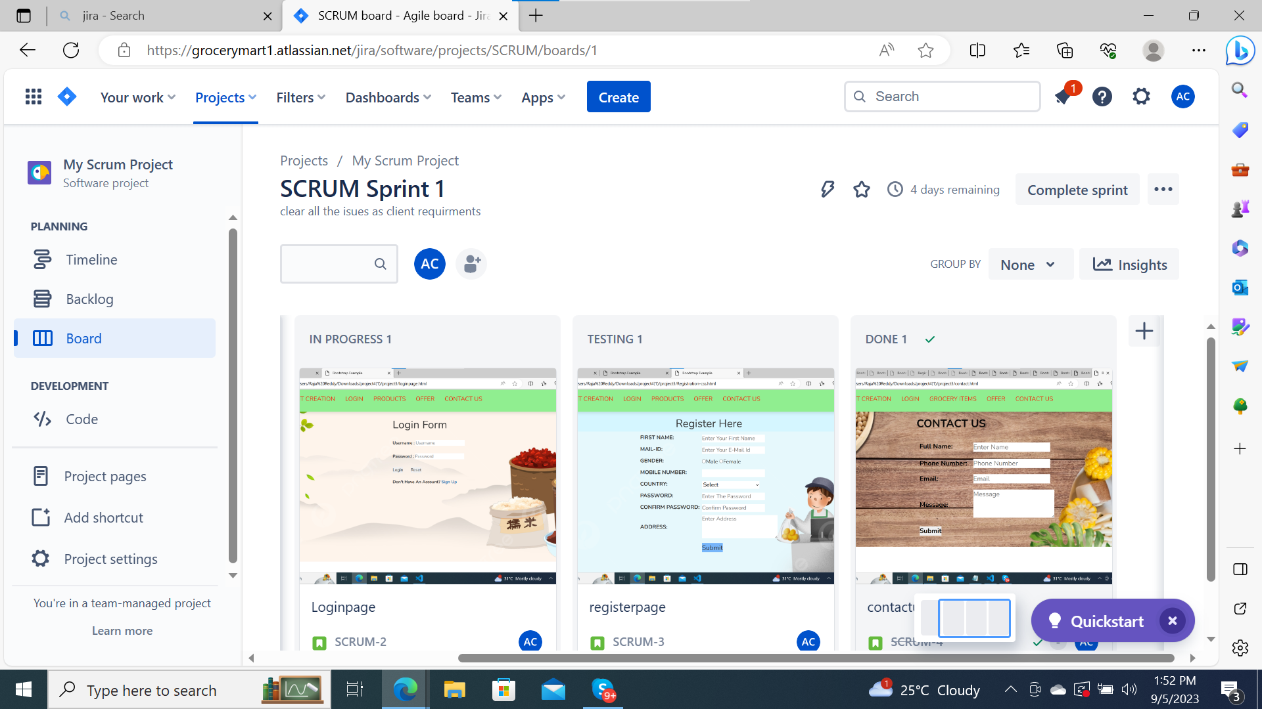
Scrum Sprint stages

Slide 17
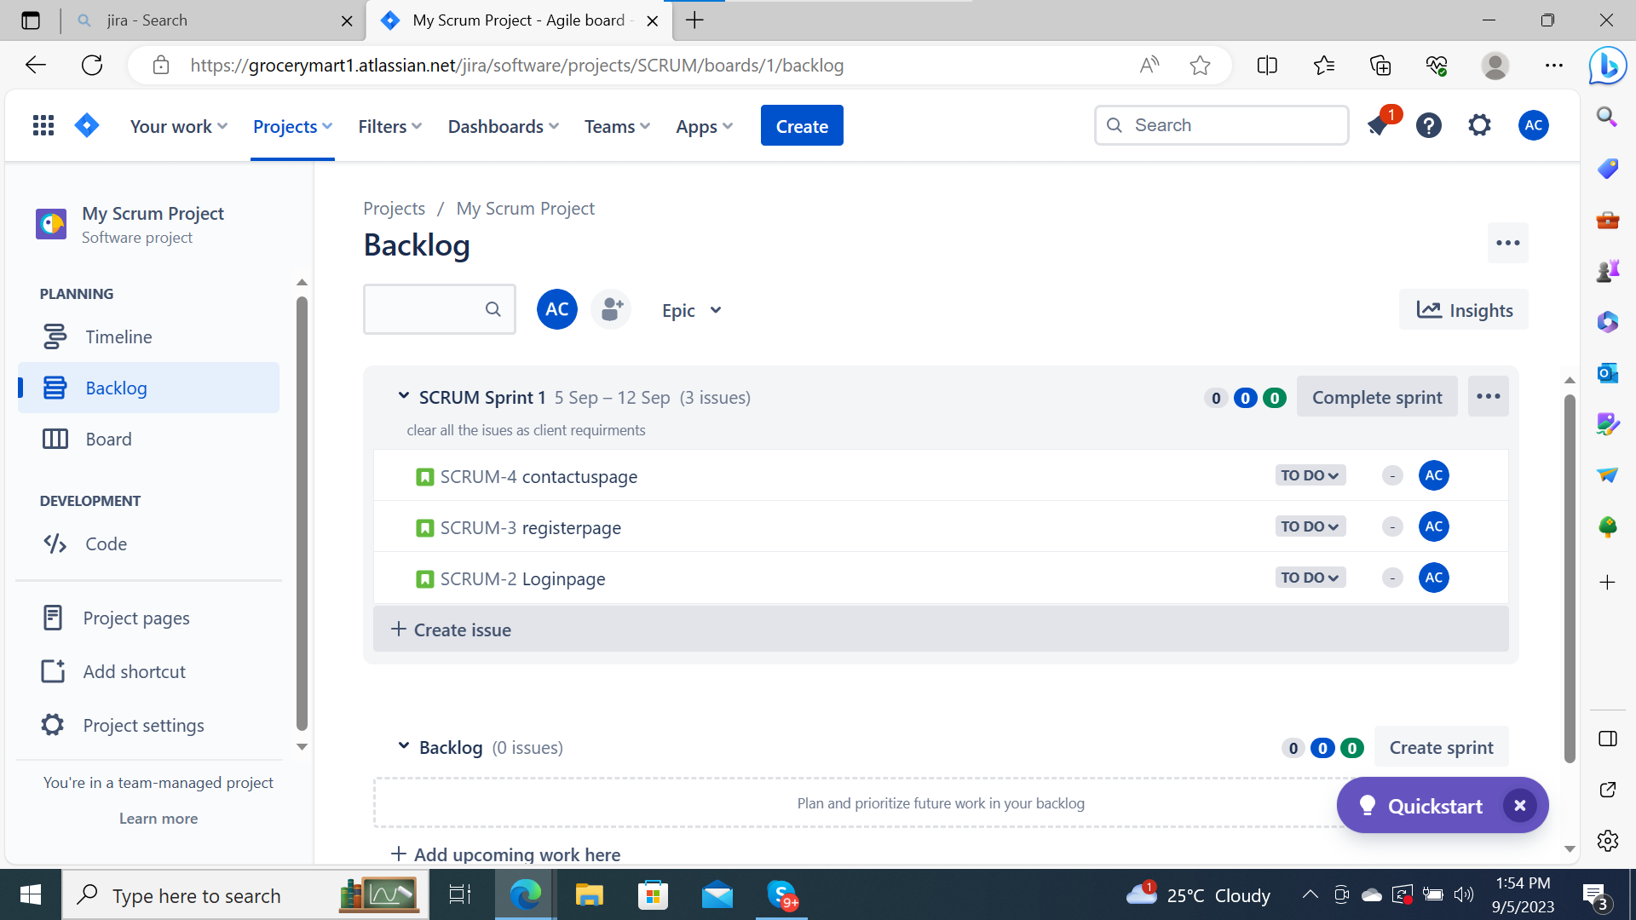
Scrum Sprint status

Slide 18


